Slide 1
IBM University Engagement Project Submission
“Exploring the Power of Agentic AI with IBM Granite and IBM Bob”

Slide 2

Project Tile – [Agentic AI for Mental Health Awareness & Suicide prevention]
Domain of Project –[ Healthcare ]
Student Name | Recent Passport Photo | Email ID | Mobile number [WhatsApp]
Anu Rai |  | anu32712@gmail.com | 9109811417

Slide 3
Problem Statement -
Problem Statement : Agentic AI for Mental Health Awareness & Suicide Prevention
The Challenge
Mental health issues such as depression, anxiety, and suicidal thoughts are growing worldwide. Stigma, lack of awareness, and limited access to timely help prevent many individuals from seeking support. Traditional systems are often reactive, leaving gaps in early detection and preventive care.
The Objective
Build an Agentic AI-powered Mental Health Awareness & Suicide Prevention Agent that is empathetic, proactive, and safe. The solution should:
Promote Awareness & Education – Share accessible resources on mindfulness, coping strategies, and self-care.
Enable Early Detection (RAG) – Use Retrieval-Augmented Generation to identify distress signals in conversations, journaling inputs, or safe online data.
Provide Empathetic Support – Build a conversational agent that listens actively and responds with empathy (with clear disclaimers: not a substitute for professional medical advice).
Predict & Prevent Risks – Forecast stress peaks, suggest preventive strategies, and issue alerts when high-risk signals are detected (with consent).
Connect to Human Support – Link users to helplines, counselors, or community support for timely intervention.

Slide 4
Proposed Solution -
Proposed Solution- AI-Powered Mental Health Awareness & Suicide Prevention Agent
The proposed solution is a multi-agent AI-powered mental health system designed to promote mental health awareness, provide empathetic support, detect early signs of emotional distress, and connect users with appropriate human help. The system focuses on providing safe, accessible, and proactive support while clearly stating that AI is not a replacement for professional medical care.
At its core, the solution uses a Retrieval-Augmented Generation (RAG) pipeline to retrieve reliable mental health information from trusted sources such as WHO, government health resources, and verified mental health organizations. This enables the system to provide accurate information about stress, anxiety, depression, mindfulness, coping strategies, and suicide prevention.
The system consists of four key agents:
Mental Health Awareness Agent provides users with easy-to-understand information about mental health conditions, symptoms, self-care, mindfulness, stress management, and available support resources.
Emotional Support Agent acts as an empathetic conversational assistant that listens to users, understands their concerns, and provides supportive and non-judgmental responses with appropriate safety disclaimers.
Risk Detection & Prevention Agent analyzes consented conversations or journal entries to identify possible signs of severe emotional distress or suicide risk. Based on the detected level of concern, it provides appropriate safety-oriented guidance and encourages the user to seek professional or emergency help when necessary.
Human Support & Helpline Agent connects users with counselors, mental health professionals, helplines, emergency services, and trusted community resources, ensuring that high-risk situations are directed toward human intervention.
IBM watsonx.ai can be used for AI model deployment, embeddings, governance, and orchestration, while IBM Granite models can support language understanding, summarization, and response generation. IBM Bob can be used to coordinate the different AI agents and workflows.

Slide 5
Technology Used
IBM Bob Platform – For designing and orchestrating multi-agent mental health workflows.
IBM Granite Models – For natural language understanding, reasoning, and empathetic response generation.
IBM watsonx.ai – For AI model deployment, embeddings, and AI governance.
RAG (Retrieval-Augmented Generation) – For retrieving reliable mental health information from trusted sources and generating accurate responses.
Vector Database (FAISS/Chroma) – For storing and retrieving mental health resources using RAG.
Streamlit / React – For developing a user-friendly dashboard for chatbot, mood/journal tracking, awareness resources, and support options.
Helpline & Emergency Resources – For connecting users with counselors, mental-health professionals, helplines, and emergency support when high-risk signals are detected

Slide 6

Role of Agentic AI in the solution
Role of Agentic AI in Mental health Awareness and suicide prevention
Agentic AI enables the Nutrition Agent to function as an intelligent, autonomous system rather than a simple chatbot. Using IBM watsonx.ai and IBM Granite models, it coordinates multiple specialized agents to deliver personalized nutrition guidance.
Each agent performs a specific role—such as retrieving nutritional data, generating diet plans, providing health advice, and analyzing food logs—while working collaboratively. This multi-agent approach ensures efficient task execution and accurate results.
Agentic AI also brings context awareness, understanding user details like age, health conditions, and fitness goals to generate tailored recommendations. It supports real-time adaptation, continuously updating suggestions based on user inputs like daily meals.
Additionally, agents communicate with each other, enabling better decision-making and improved outcomes.
Overall, Agentic AI makes the system proactive, personalized, and goal-driven, acting like a smart digital that helps users maintain a healthy lifestyle.

Slide 7
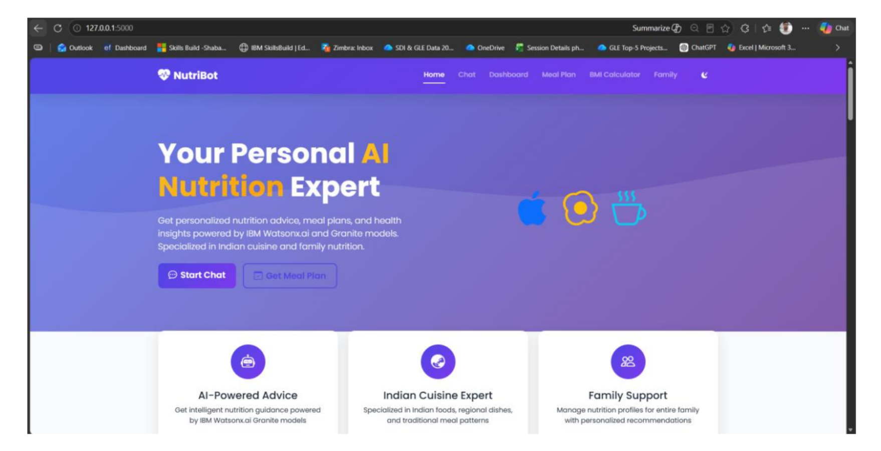
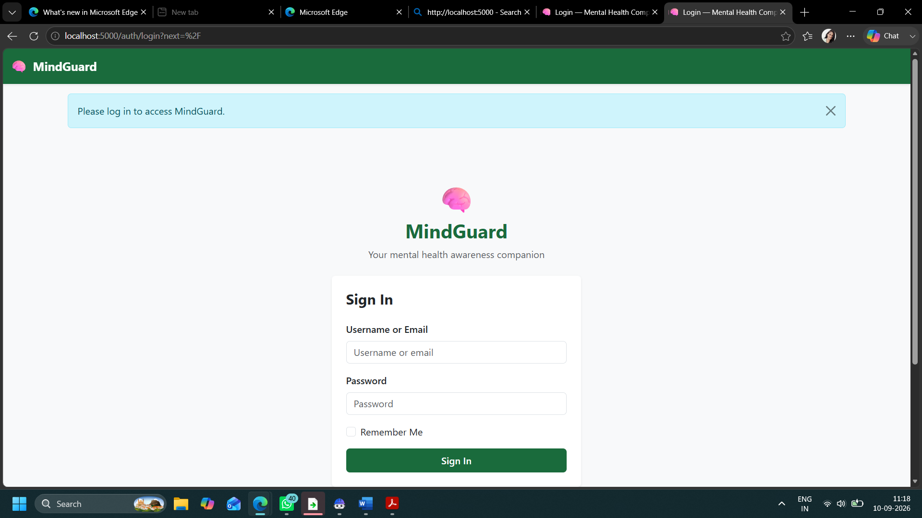
Project Output Screenshot
Please put IBM Bob output screenshots with 2-3 prompts.
You can take 2-3 more slides for each screenshot
·
·
·

Slide 8
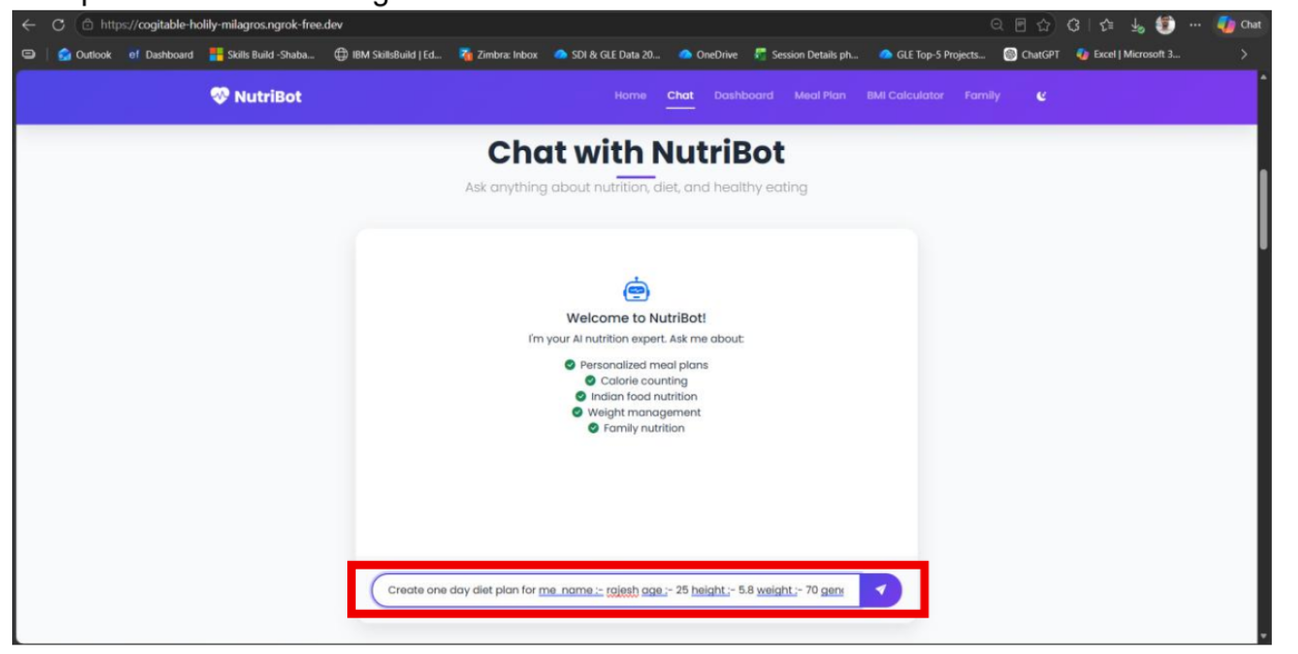
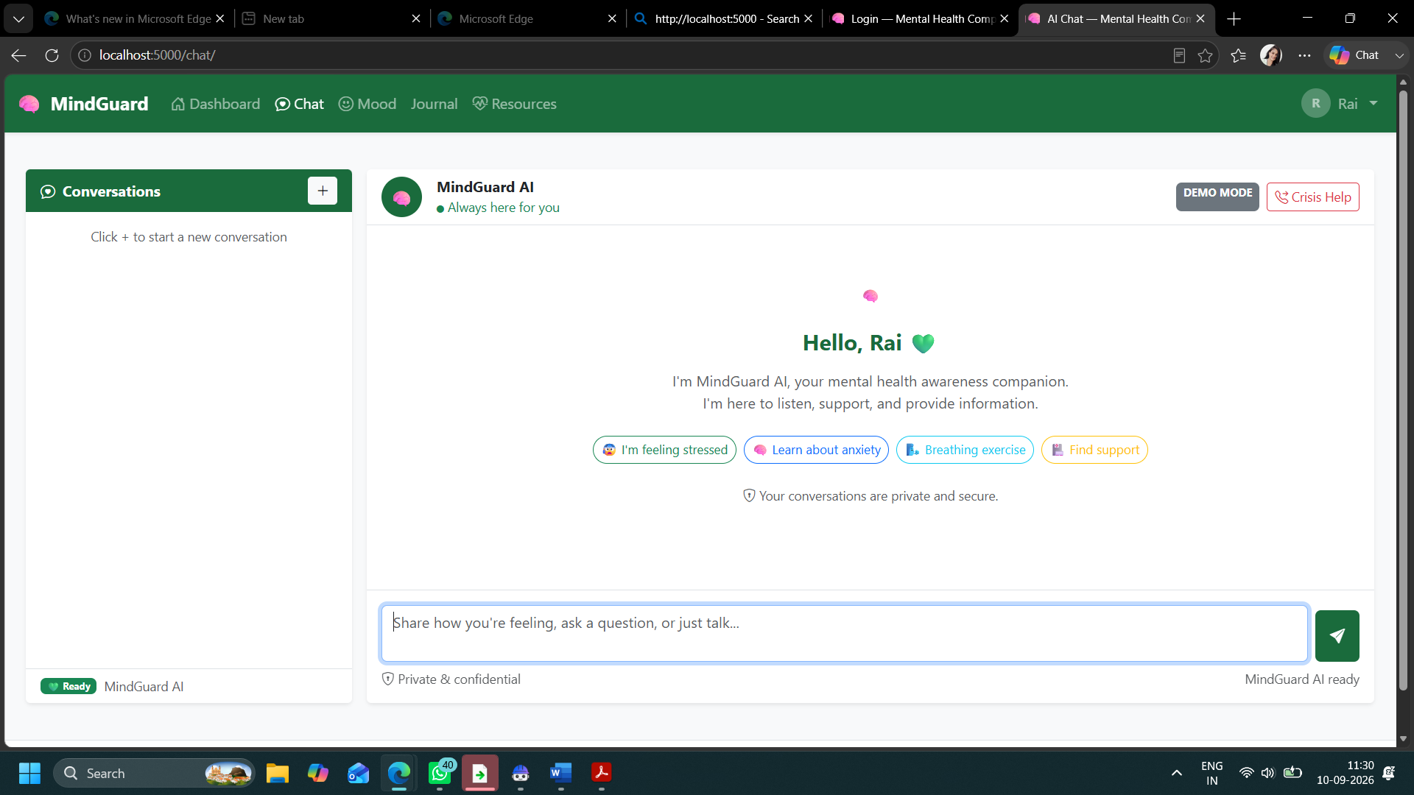
Project Output Screenshot
Please put IBM Bob output screenshots with 2-3 prompts.
You can take 2-3 more slides for each screenshot
·
·
·

Slide 9
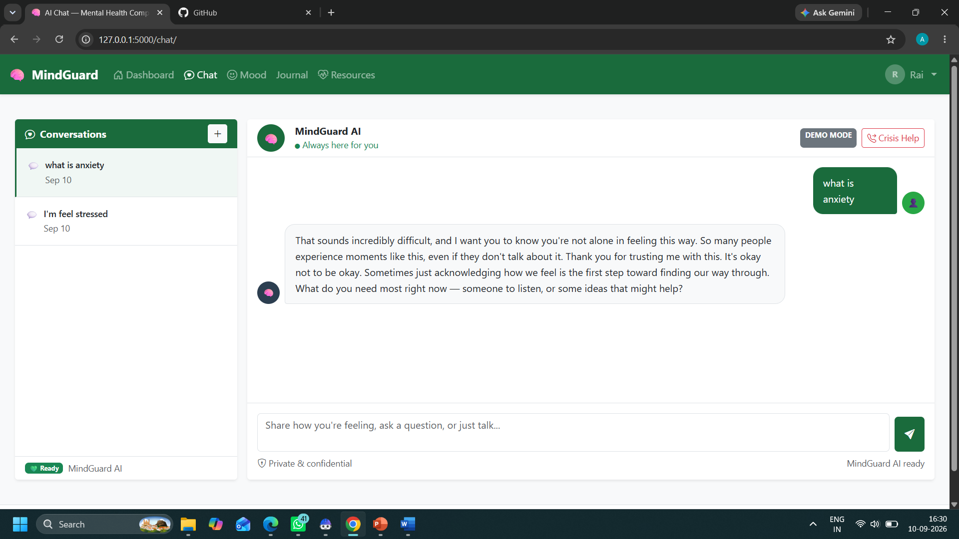
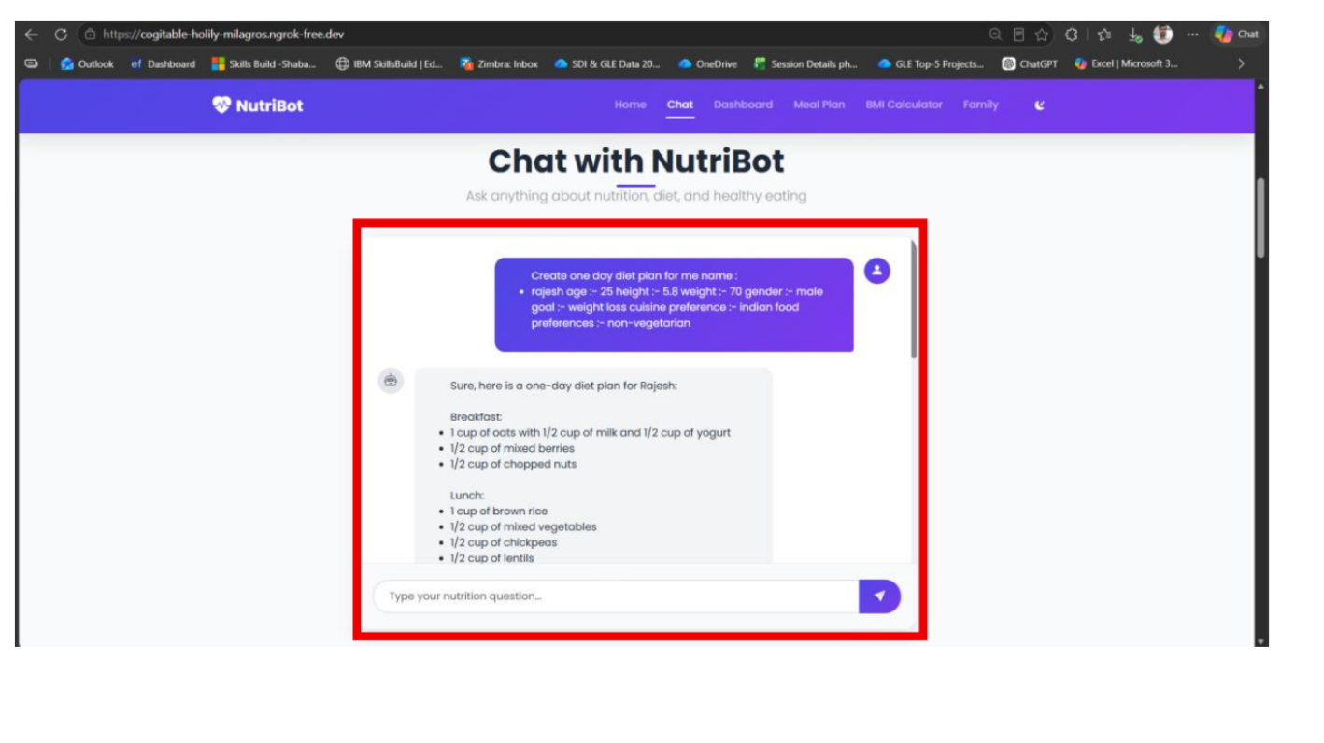
Project Output Screenshot
Please put IBM Bob output screenshots with 2-3 prompts.
You can take 2-3 more slides for each screenshot
·
·
·

Slide 10
Novelty and Uniqueness
The proposed Mental Health Awareness & Suicide Prevention Agent stands out by combining Agentic AI, RAG, early risk detection, and personalized support into a single intelligent system.
Multi-Agent Intelligence – Multiple specialized agents collaborate to provide awareness, emotional support, risk detection, and human-support services.
RAG-Based Accuracy – Retrieves information from trusted mental-health sources before generating responses, helping reduce misinformation.
Early Risk Detection – Identifies potential signs of severe emotional distress or suicidal thoughts from consented conversations or journal inputs.
Personalized Support – Provides suitable coping strategies, mindfulness activities, and self-care suggestions based on the user's needs.
Proactive Prevention – Goes beyond responding to users by encouraging healthy coping practices and early intervention when warning signs appear.
Human Support Connection – Connects high-risk users with helplines, counselors, mental-health professionals, or emergency services.
Safe & Responsible AI – Uses clear disclaimers, consent-based monitoring, privacy considerations, and human intervention instead of replacing professional care.
IBM-Powered & Scalable – Uses IBM Bob, IBM Granite models, and IBM watsonx.ai for multi-agent orchestration, AI responses, deployment, and governance.

Slide 11
Git Hub Link
https://github.com/AnuRaiCodes/Mindguard-Mental-Wellness
·
·
·

Slide 12
Future Scope
1. Integration with Wearable Devices –
The system can connect with smartwatches and fitness trackers to monitor sleep, heart rate, and activity patterns, helping identify changes in mental well-being.
2. AI-Powered Voice & Multilingual Support –
Voice interaction and multiple language support can make the system easier and more accessible for users from different backgrounds.
3. Advanced Early-Risk Detection –
Future versions can improve the detection of emotional distress and suicide-risk signals while maintaining user consent, privacy, and safety.
4. Personalized Mental Wellness Plans –
The system can provide personalized mindfulness, stress-management, and self-care plans based on the user's mood and interactions.
5. Real-Time Human Support –
The system can be further connected with counselors, helplines, and emergency services for faster intervention during high-risk situations.
·
·
·

Slide 13
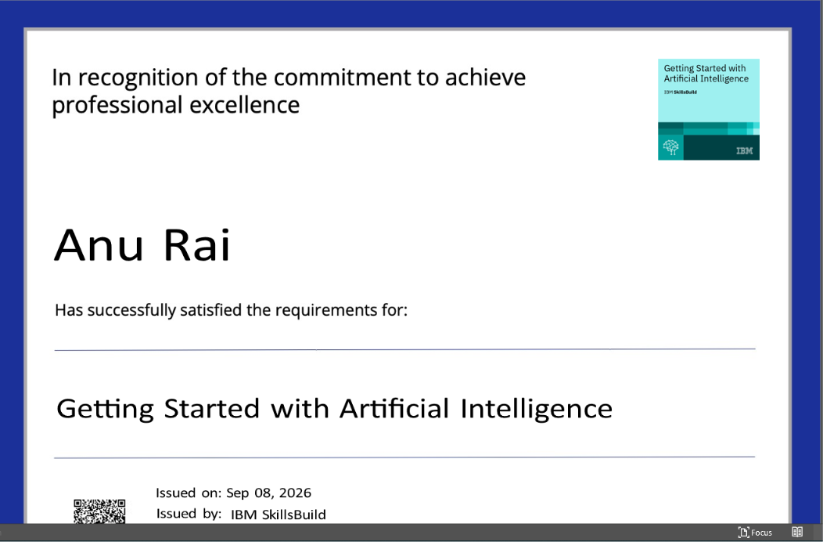
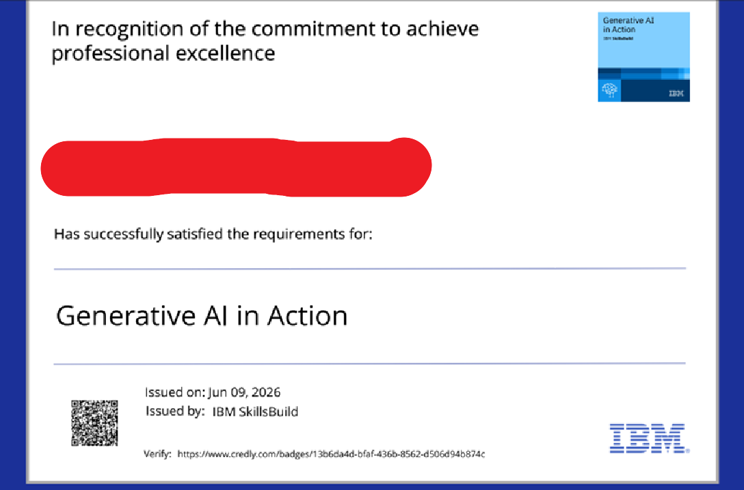
Certificates Earned:
Please add your credly certificate

Slide 14
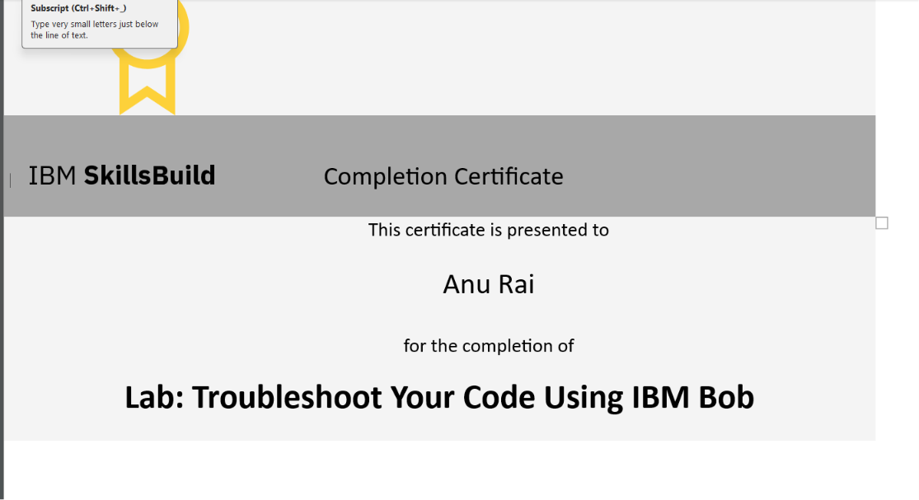
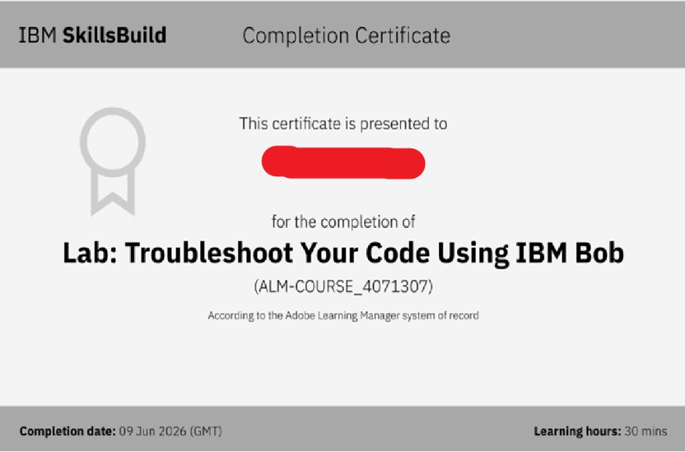
Certificates Earned:​
Add your IBM BOB Certificate

Slide 15


